Slide 1
Device-Free Counting via Wideband Signals
IEEE JOURNAL ON SELECTED AREAS IN COMMUNICATIONS, VOL. 35, NO. 5, MAY 2017
Stefania Bartoletti, Member, IEEE
Andrea Conti, Senior Member, IEEE
Moe Z. Win, Fellow, IEEE

Slide 2
Image-based
LOS？Light？ Colors？Privacy？
device-based
Counting system
RFID（tags）？WIFI access points（safety/privacy）？
Radio-based
Lower implementation costs；higher privacy preservation。
device-free

Slide 3
Device-free counting radar networks multi-target detection
individual-centric
set of measurements is associated with each detected target.
estimating its position and trajectory → number of targets
high complexity growing exponentially with the number of targets due to data association (it is unnecessary when the system is interested in only the number of targets and not their locations).
crowd-centric
infer the number of targets directly from the measured data without estimating their locations.
Good candidate: sensor radars based on wideband signals (e.g. UWB), fine delay resolution.

Slide 4
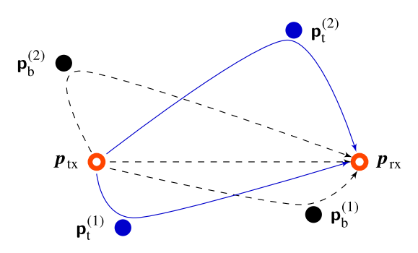

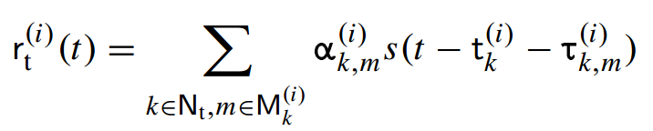
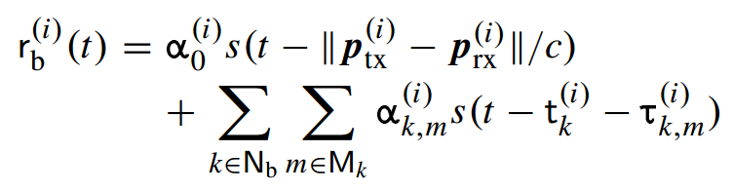
SYSTEM MODEL
Notes:
为什么公式里面不考虑其他对的收发机的信号影响。

Slide 5
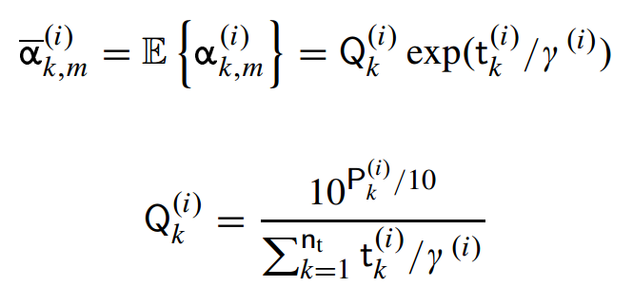


S-V 信道模型
在无线通信中，电磁波的传播可以用传播径近似表征。传播径可以通过一个多维参数集描述，该参数集一般包括能量、时延、到达角和离开角等多径特性。一般将具有相近参数的多径归为一个簇进行统计特性研究 。
the received signal after background removal.

Slide 6




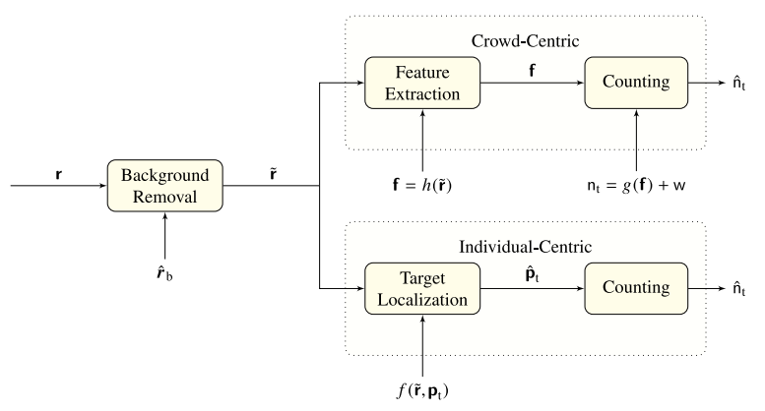

Slide 7





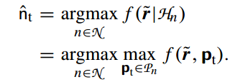
individual-centric method
model order selection
Target position

Slide 8
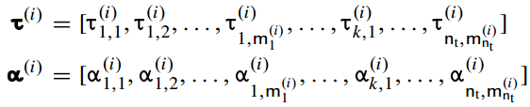



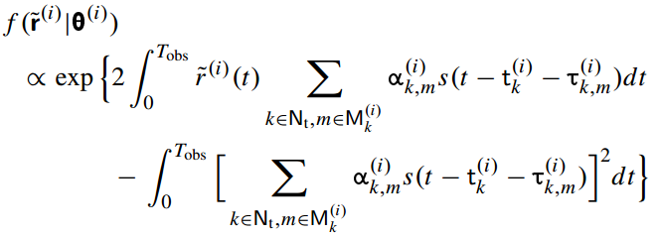
individual-centric method
参数向量
channel instantiation
unknown

Slide 9
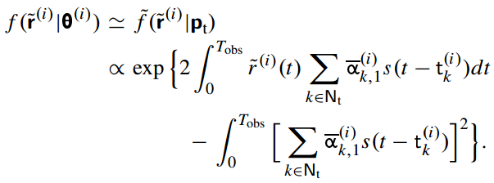
individual-centric method
Tractable Likelihood Function
single-bounce channel
the amplitude is averaged over small-scale fading

Slide 10
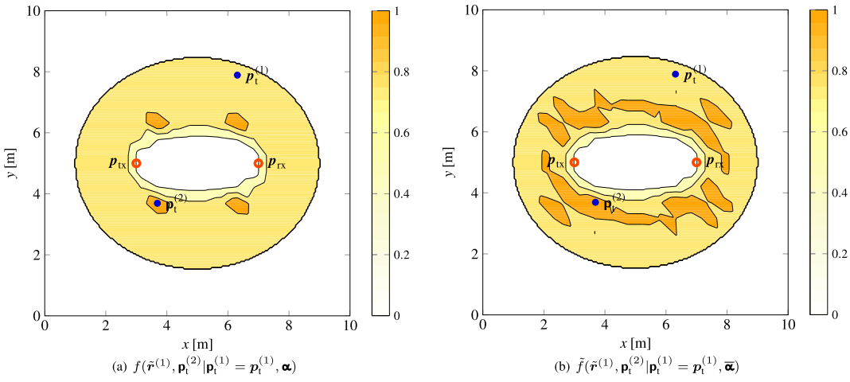
individual-centric method

Slide 11
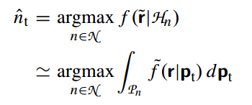

individual-centric method
model order selection problem
均匀分布

Slide 12


crowd-centric method
Vector of observable features f
Feature extraction function
Observation function

Slide 13


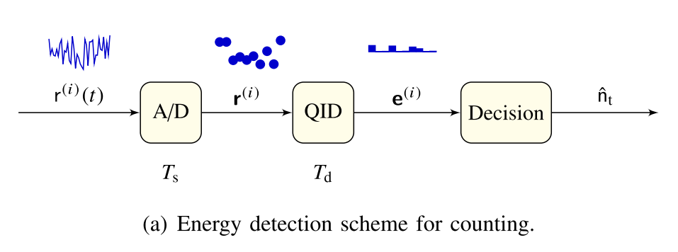




crowd-centric method
Energy detection

Slide 14
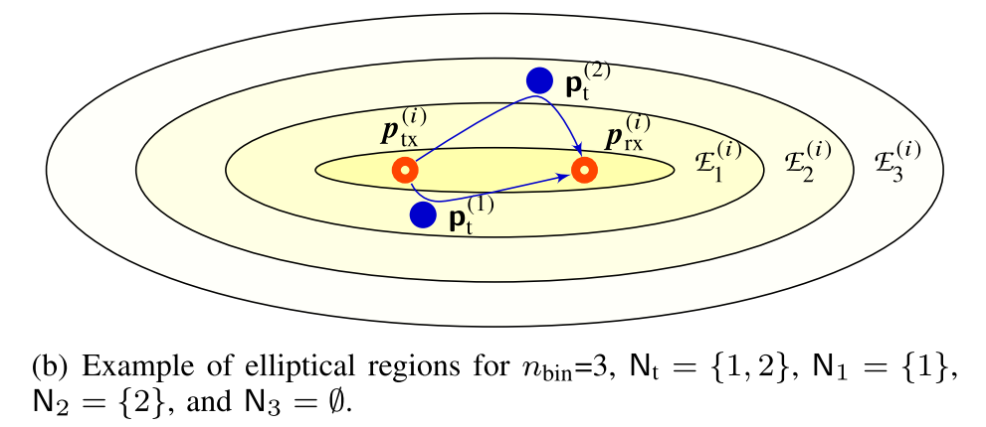




crowd-centric method
Energy bin vector 的几何描述

Slide 15




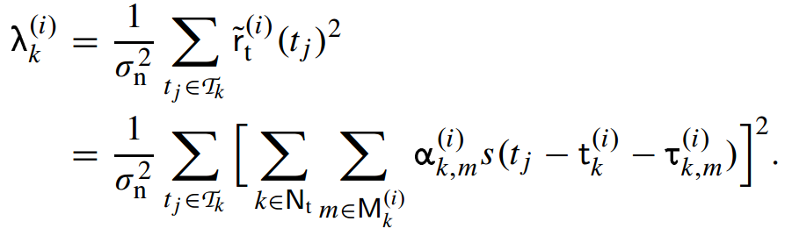
Feature extraction
根据 channel instantiation 条件下的 χ² 分布。

Slide 16


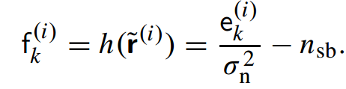



Feature extraction
Unknown parameters & not invertible.

Slide 17
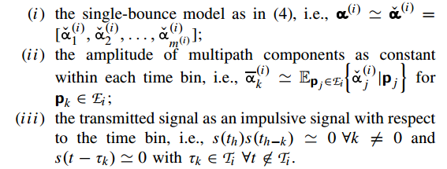
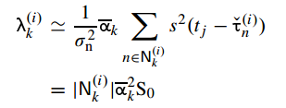
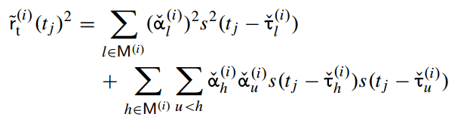

Tractable Observation Function

Slide 18


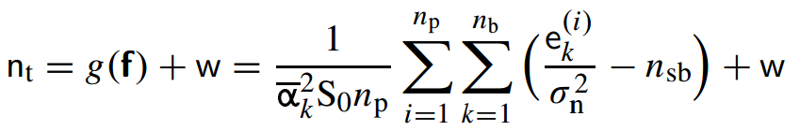
Tractable Observation Function
depends only on the targets located inside

Slide 19
案例性能分析 不写了太多了

